Slide 1

Retrieving URL

Slide 2

Reference
Chapter 13 (O'Reilly) of Hands-On ML
Hvass Lab’s GitHub and Youtube
Paper
Youtube
Code

Slide 3
Inception v3 Download

Slide 4
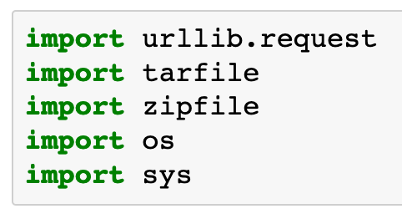

Slide 5
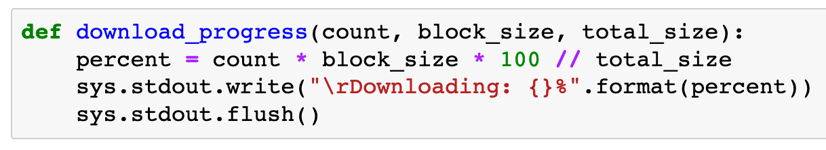

Slide 6
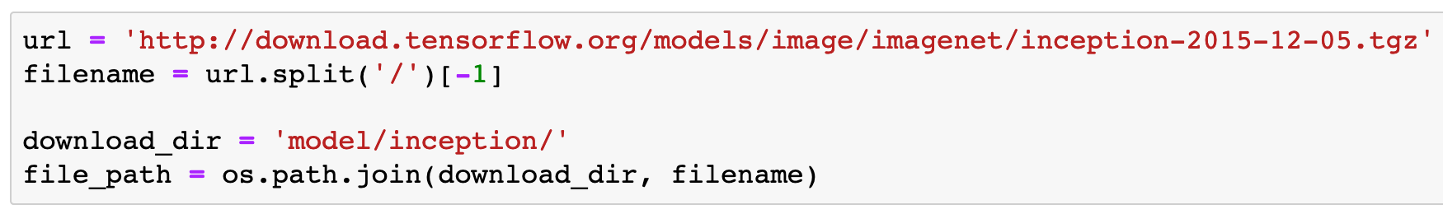

Slide 7
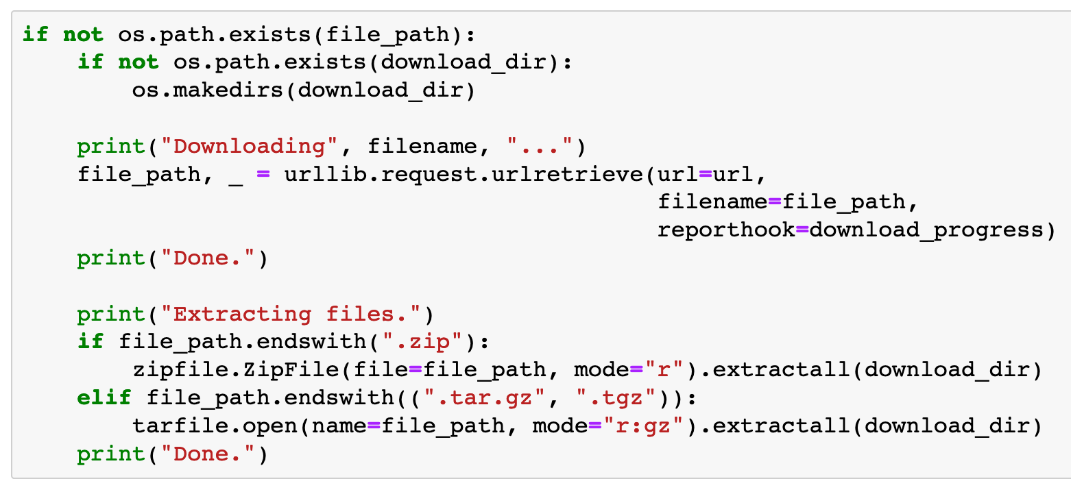

Slide 8
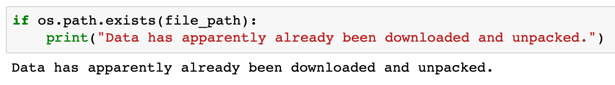

Slide 9
Now
Let’s Play with Code

